Slide 1


Social Buzz

Slide 2


Today's agenda
Project recap
Problem
The Analytics team
Process
Insights
Summary

Slide 3

The "Social Buzz" project aimed to analyze and understand the public's engagement and sentiment toward our brand across various social media platforms. The project focused on collecting, processing, and analyzing social media data to uncover trends, sentiment, and influential voices shaping the conversation around our brand.
Project Recap

Slide 4

Problem
To Find the trends of Social Buzz
To Know how the people are reacting on the top categories
To know the top 5 categories

Slide 5
Andrew Fleming
Chief Technical Architect
The Analytics team
Marcus Rompton
Senior Principle
Shashank
Intern

Slide 6
Process
1
Data gathering
2
Data Pre-processing
3
Data Cleaning
4
Data Mining
5
Getting Insights by Data Visualisation

Slide 7

Insights
Top 5 Categories by their Score
74,965
71,168
69,338
68,738
Animals
Healthy Eating
66,676
Science
Technology
Food

Slide 8
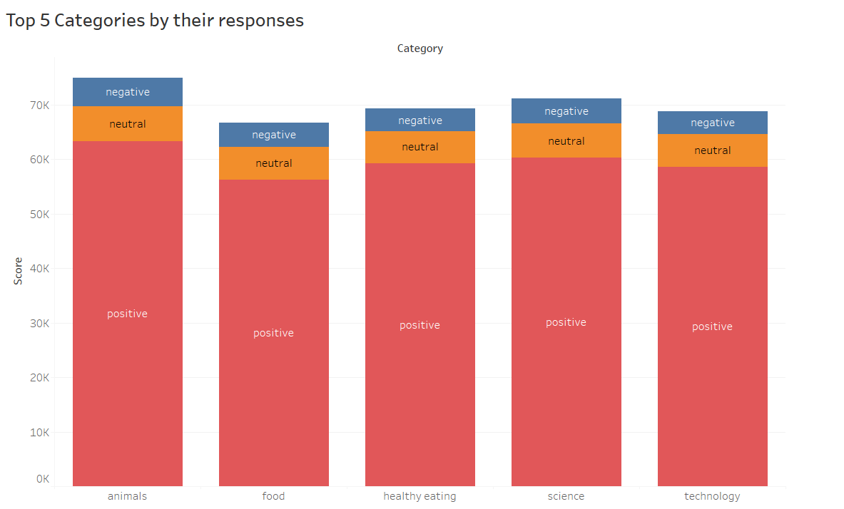

Slide 9
As you can see in the above barplot which shows how the audience responded to these top 5 categories of Social buzz
Top 5 categories by their Positive responses
Top 5 categories by their Neutral responses
Top 5 categories by their Positive responses
1. Animals
2. Science
3. Healthy Eating
4. Technology
5. Food
1. Animals
2. Science
3. Technology
4. Food
5. Healthy Eating
1. Animals
2. Science
3. Food
4. Healthy Eating
5. Technology

Slide 10
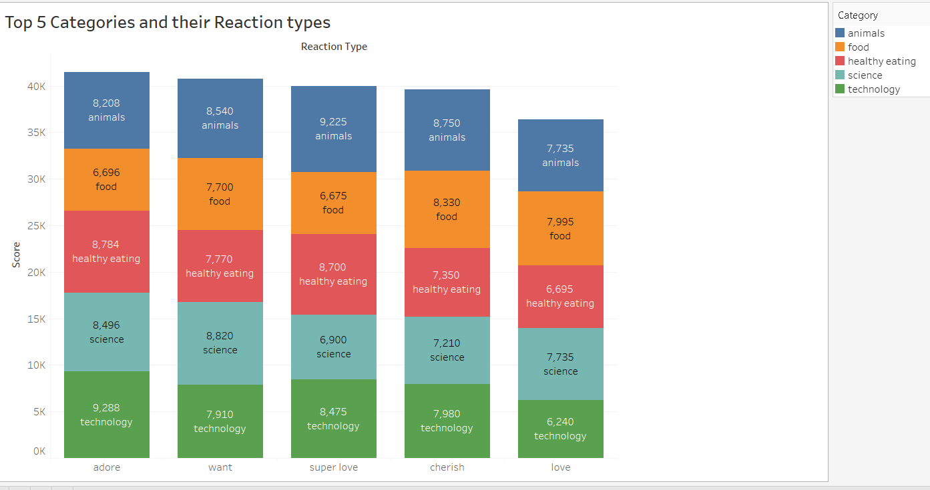
Top 5 Categories by their Reaction types

Slide 11

By all of the above insights we can conclude that the top two popular is the “Animal” and “Science” category in all consequences whether it’s a positive or negative but the top one is “Animal” and the audiences are more drawn towards these categories.
Summary

Slide 12
Thank you!
ANY QUESTIONS?

